Slide 1


Step up your C# game with 5 popular NuGets

Slide 2

Let Me Introduce Myself
I’m Not Quite Retired (Although I Keep On Trying!!)
I’ve founded companies, led all sorts of teams, built interesting software, invented stuff, open-sourced . . . source, used giant telescopes to stuff my eyeballs full of photons, and managed to be that most rare sort of cat: a currency trader who isn’t broke. A happily-expatriate New Yorker, I live in Drexel Hill with my lovely and talented set/costume designer wife, Marie Anne Chiment.
Louis Berman
SQUIDEYES, LLC

Slide 3

In the dark ages of .NET, developers had to crawl the internet for dependencies, run installers, create bloated lib folders, and possibly introduce assemblies into the [GAC]. Gross! Those who remember will agree it was terrible, but it’s better now!
(Khalid Abuhakmeh; JetBrains Developer Advocate!)

Slide 4
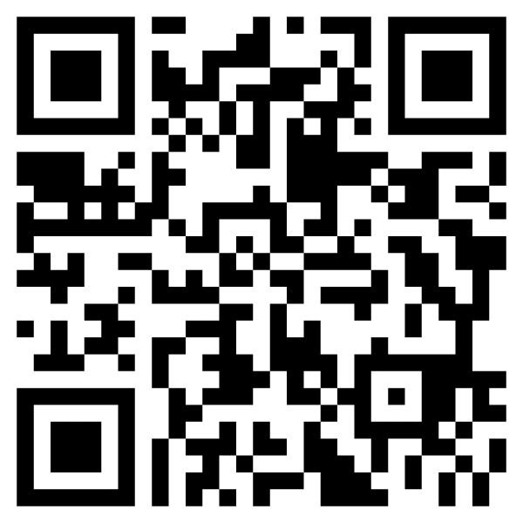

Resources

Slide 5

Five Game-Changers
Guard Clauses – guard your parameters
Vogen – cure your primitive obsession
Stateless – state machines made easy
Bogus – generate fake data for testing
SquidEyes.Testing – test your logging

Slide 6
Roll Your Own
365K Packages
5M Versions
233B Downloads
Dead Simple
Free
Improved DevOps
Saves Time + Money

Slide 7

Why Stop At Only Five?
There are too many NuGet’s to attempt to survey the field, but a great place to start would be the awesome “Awesome NuGet Packages” repo
The https://www.fuget.org search engine is another awesome resource

Slide 8

Nick Chapsas
Prolific Creator
http://nickchapsas.com
C#, .NET, Azure, AWS, open-source
His Essential NuGets Packages in .NET videos are a must watch
11 Episodes; on Polly, xUnit, Moq, Fluent Assertions, OneOf, etc.

Slide 9
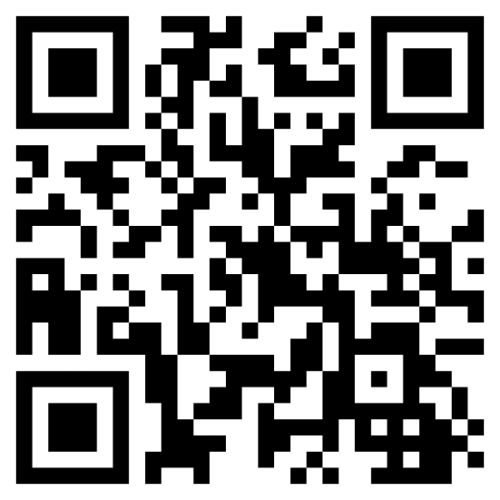
I’m Here to Help!
Louis Berman
SQUIDEYES, LLC

Slide 10
Thank you!!

